Slide 1
[IPB11kW] HVDC: E2E concept
Delta November 2022

Slide 2
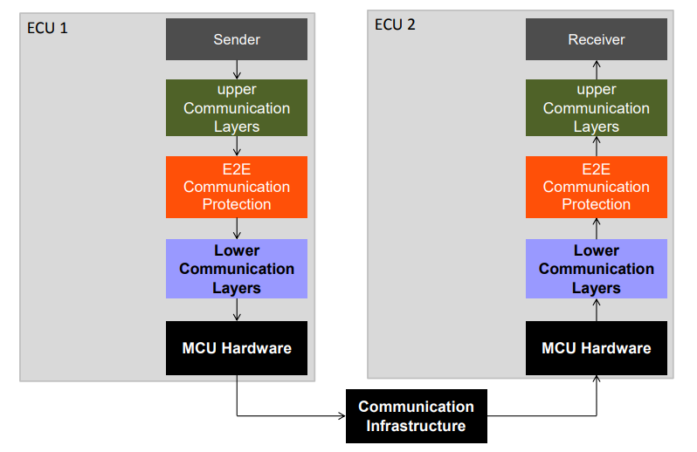
E2E – End-to-End Protection
ISO26262:6 states that freedom of interference with respect to the exchange of information shall be ensured to achieve ASIL B level qualification of system. E2E protection helps achieve this goal.
The concept of E2E communication protection assumes that safety-related data exchange shall be protected at runtime against the effects of faults on the communication link.
Faults detected between a sender and a receiver using E2E communication protection include systematic software faults, such as faults that are introduced on the lower communication layers of sender or receiver, and random hardware faults introduced by the MCU hardware, communication peripherals, transceivers, communication lines or other communication infrastructure.

Slide 3
E2E – End-to-End Protection
The E2E communication protection allows the following:
It protects the safety-related data to be sent by adding control data,
It verifies the safety-related data received using this control data, and
It provides the check result to the receiver, which then has to handle it sufficiently.
E2E communication protection aims to detect and mitigate the causes for or effects of communication faults arising from:
(systematic) software faults,
(random) hardware faults,
transient faults due to external influences

Slide 4
E2E Configuration in IPB11kW HvDc
In IPB11kW, TI F280049PZQ is used for HvDc system and CAN protocol is used for communicating safety related data between HvDc and COM controller.
Configuration:
Identify all CAN signals pertaining to safety related data.
Configure DBC file (CAN database) to add CRC and Message counter bytes in each of these CAN messages.
Extract this information in the form of .c and .h files for SW using CANgen tool.
NOTE: CANgen tool is a DELTA tool which helps in identifying and creating macros and arrays for easy use of DBC data. It extracts data from DBC file into .c and .h file such as, CAN message id, dlc, signals, macros to read or write in these signals, E2E protection status, byte location of CRC, message counter and signal data.

Slide 5
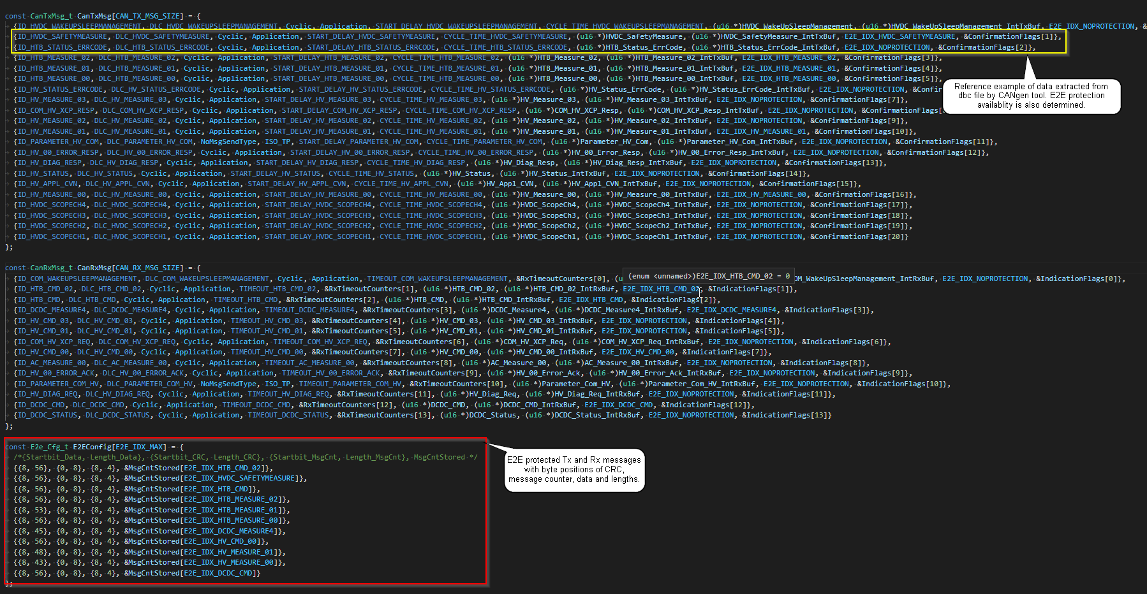
E2E Configuration in IPB11kW HvDc
E2E configuration is extracted in dbc_message.c/.h files: https://desoeap16.delta.corp/svn/IPB_PPE_auto_porsche/branches/HVDC_Branch/SW_HvDc_NewHeater/30_Bsw/ComStack/dbc/GeneratedConfigFiles

Slide 6
E2E Execution in IPB11kW HvDc
HvDc SW 6 Tx and 4 Rx messages which are E2E protected. Each of these 10 messages have 1 byte CRC and 1 byte message counter in the CAN message. CRC8 method is used for CRC calculation and verification. Message counter is 1 byte data in the range of 0-15 which is incremented every cycle of a message.
Transmit messages:
- Cyclically transmit message with data, message counter byte incremented by 1 from previous transmission and CRC calculated over data and message counter.
TxMsg Cycle time elapsed
E2EProtected ==
True
Yes
Determine the following:
CrcIdx
MsgCntIdx
MsgCntPos
MsgCnt++
Calculate Crc over (data+MsgCounter)
Forward the CAN Msg with Crc and MsgCounter added to lower layer
No
Forward the CAN Msg immediately to lower layer

Slide 7
E2E Execution in IPB11kW HvDc
Received messages:
Verify if message received is expected to be E2E protected.
If no, then forward the message to upper layer as is.
If yes, monitor the message counter for following scenarios:
1. Out of bounds – message counter received is within accepted range 0-15.
RxMsg
E2EProtected ==
True
0 <= MsgCounter <= 15
Yes
Determine the following:
CrcIdx
MsgCntIdx
MsgCntPos
Yes
Check if MsgCounter is incremented correctly
(next slide)
No
No
Forward the CAN Msg immediately to upper layer
MsgCtrSts = Invalid

Slide 8
E2E Execution in IPB11kW HvDc
2. Valid message counter - message counter received is incremented by only 1 over previous reception.
Calculate CRC over data and message counter of received message and validate.
MsgCounter ==
(Last received+1)
MsgLostFlag==True
healing_ctr < 5
CRCcheck ==valid
Yes
MsgCtrSts = Valid
Yes
Yes
Yes
healing_ctr++
Yes
Yes
MsgCrcSts = Valid
No
No
No
debounceCtr = 0
msg_lost_ctr = 0
healing_ctr = 0
MsgLostFlag = 0
timeout = 0
No
Check if MsgCounter same as last
(next slide)
MsgCrcSts = Invalid
Combine MsgCtrSts and MsgCrcSts to determine the state of msg E2E protection status

Slide 9
E2E Execution in IPB11kW HvDc
3. Repeated counter - message counter received same as previous and is repeated only for a limited number of occurrences.
Calculate CRC over data and message counter of received message and validate.
MsgCounter ==
(Last received)
debounceCtr < 5
MsgLostFlag== True
healing_ctr > 0
debounceCtr++
MsgCtrSts = Valid
healing_ctr--
No
MsgCtrSts = DebounceMaxReached
No
Check if Msgs were lost
(next slide)
CRCcheck ==valid
MsgCrcSts = Valid
No
MsgCrcSts = Invalid
Combine MsgCtrSts and MsgCrcSts to determine the state of msg E2E protection status
9

Slide 10
E2E Execution in IPB11kW HvDc
4. Few messages lost - message counter received is incremented by more than 1, but still within permitted limits.
Too many messages lost - message counter received is incremented by more than accepted limit.
Calculate CRC over data and message counter of received message and validate.
MsgCounter <=
(Last received+5)
msg_lost_ctr < 5
healing_ctr > 0
MsgLostFlag = True
msg_lost_ctr ++
MsgCtrSts = Valid
healing_ctr--
No
No
MsgCtrSts = TooManyMsgsLostTooManyTimes
CRCcheck ==valid
MsgCrcSts = Valid
Combine MsgCtrSts and MsgCrcSts to determine the state of msg E2E protection status
No
MsgCrcSts = Invalid
MsgCounter >=
(Last received+5)
healing_ctr > 0
MsgLostFlag = True
MsgCtrSts = TooManyMsgsLost
healing_ctr--
Combine MsgCtrSts and MsgCrcSts to determine the state of msg E2E protection status

Slide 11
E2E error detection and reaction in IPB11kW HvDc
Based on validation status following actions will be taken:
If CRC and message counter were successfully validated, forward the signal data to upper layer.
If message counter is invalid, ignore the signal data, set the status of E2E message as invalid and start an error counter.
If CRC is invalid, ignore the signal data and set the status of E2E message as invalid.
If error counter crosses threshold or invalid CRC is detected start a timer for 500ms. If the error is not healed in this time period, use default signal data values.
MsgCtrSts = Valid
MsgCtrSts == Valid
&&
MsgCrcSts == Valid
MsgCtrSts = DebounceMaxReached
Forward the CAN Signal data to upper layer
MsgCtrSts = TooManyMsgsLostTooManyTimes
MsgCtrSts = TooManyMsgsLost
Start 500ms timeout
MsgCtrSts = Invalid
timeout == Max
MsgCrcSts = Valid
use_default_flag = Set
This flag will be used in comServ module to determine use of default value of signals in case of persistent errors
MsgCrcSts = Invalid

Slide 12
Smarter. Greener. Together.

